Slide 1
Azure Administration

Slide 2




Cloud Computing
Virtual Infrastructure
Pay As You Go/ Pay As You Use - Rental Service – On Demand
Scalability / Elasticity
Highly Available
Shared Resources
Accessed via Internet
Security
Low Latency
Delivery of computing services over internet

Slide 3


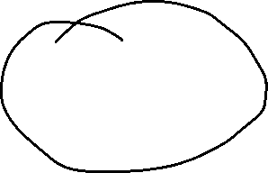



Slide 4
Azure
Cloud Offering from Microsoft
Global Presence

Slide 5
Azure Portal
Azure Portal lets you build, manage and monitor everything from simple web apps to more complex cloud application in a single, unified console
Search resources, service and docs
Manage resources
Access the cloud shell
Receive notifications
Links to Azure documentation

Slide 6
Azure Mobile App
Help you keep track of your resources while on-the-go
Stay connected to the cloud and check status and critical metrics
Diagnose and fix issues quickly
Run commands to manage Azure resources

Slide 7
Azure Cloud Shell
Interactive, browser-accessible shell for managing Azure resources.
Bash and Powershell

Slide 8
Azure PowerShell
https://learn.microsoft.com/en-in/powershell/azure/install-azure-powershell?view=azps-10.3.0
https://learn.microsoft.com/en-in/powershell/module/az.accounts/?view=azps-10.3.0#accounts

Slide 9
Azure CLI
https://learn.microsoft.com/en-in/cli/azure/install-azure-cli
https://learn.microsoft.com/en-in/cli/azure/reference-index?view=azure-cli-latest

Slide 10
Resource Manager

Slide 11
Resource Manager
You would want to deploy, manage and monitor the resources as a group.

Slide 12
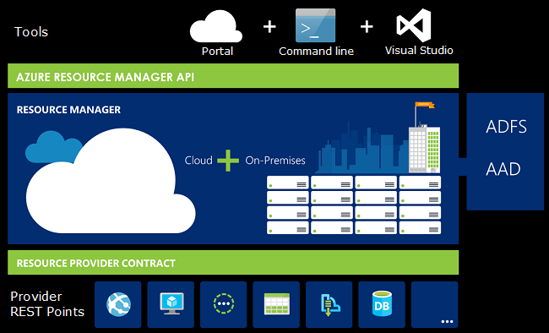




Consistent Management Layer

Slide 13
Terminologies
Resource – A manageable item that is available through Azure. Ex: Virtual Machine, Storage Account, Web App, VNet, Database
Resource Group – A container that holds related resource for an Azure solution
Resource Provider – Service that supplies the resource you can deploy and manage through Resource Manager. Ex: Microsoft.Compute – Virtual Machines, Microsoft.Storage – Storage Account, Microsoft.Web – Web Apps

Slide 14
Resource Group
At simplest a logical collection of resources
Resources can be deployed to any new or existing resource group
Resources can only exist in one resource group
Resource groups cannot be renamed
Resource groups can have resources of many different types
Resource groups can have resources from many different region

Slide 15



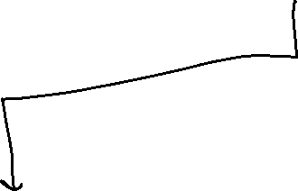






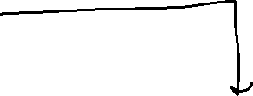



Slide 16
Deploying Resources in Resource Group

Slide 17
Resource Manager Locks
Allows you to put up a structure in place that prevents accidental deletion of resource
Two Types
Read-Only Lock – Prevents any changes to the resource
Delete Lock – Prevent deletion
Owner and User Access Administrator roles can create or delete management locks.

Slide 18
Moving Resources
When moving resources, both the source group and target group are locked during the operation
https://learn.microsoft.com/en-us/azure/azure-resource-manager/management/move-support-resources

Slide 19
Resource Group Deletion
Be cautious when deleting resource group as every single thing in the resource group will get deleted and there is no way to recover it

